Slide 1
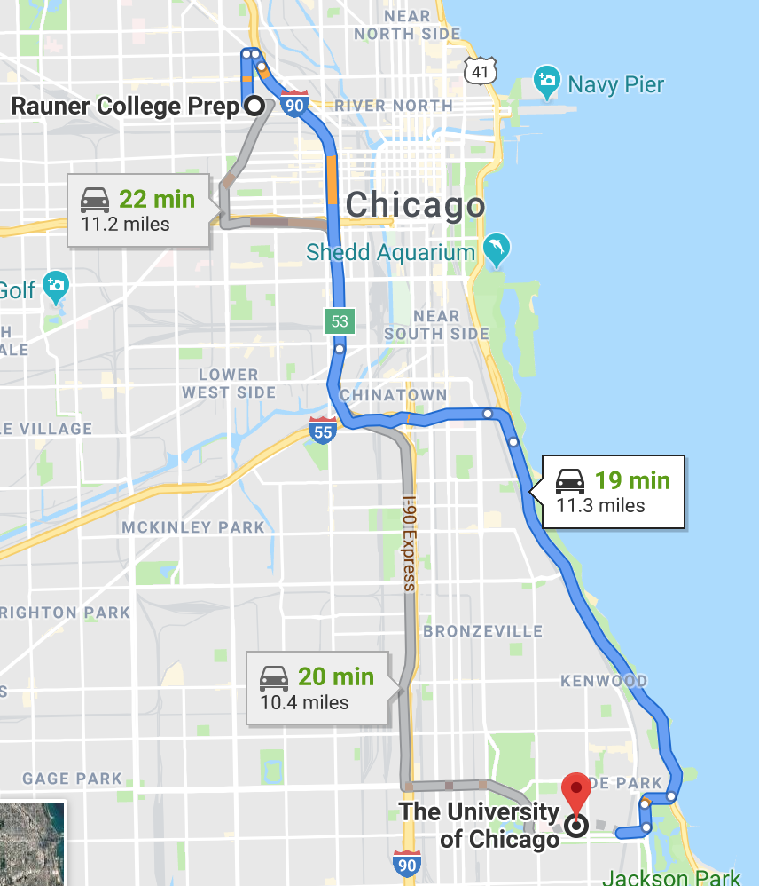
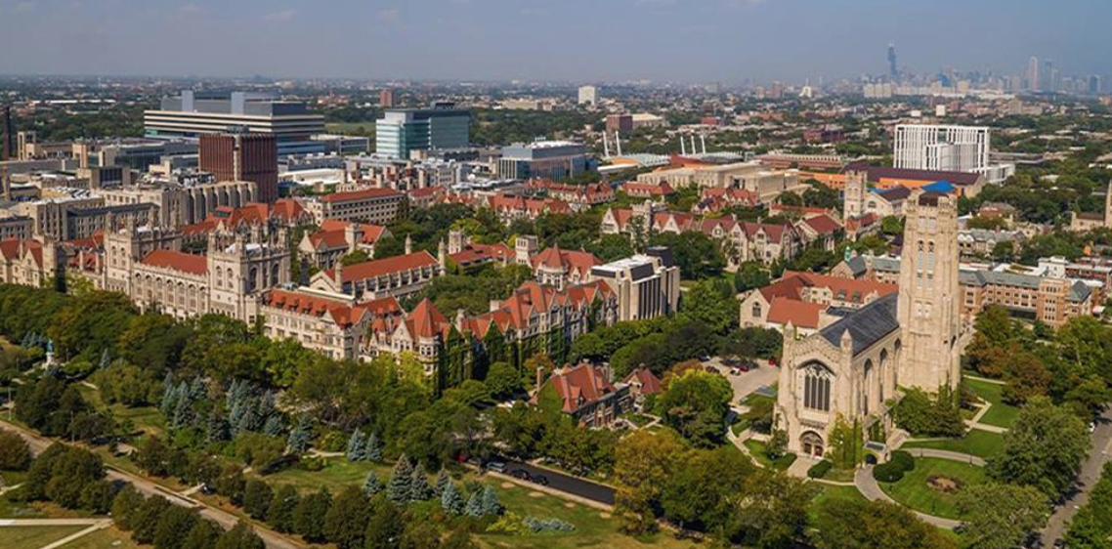

We are researchers from the University of Chicago that use coding to help us answer biological questions.

Slide 2
K-12
Undergraduate (4 years)
Graduate School (1-2 years of classes, 3-5 years of research)
Postdoc Researcher (2+ years)
Professor
The path to becoming a professor
Also lots of options in industry for STEM PhDs, particularly for those with coding skills!

Slide 3
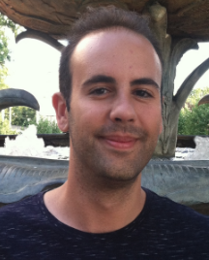
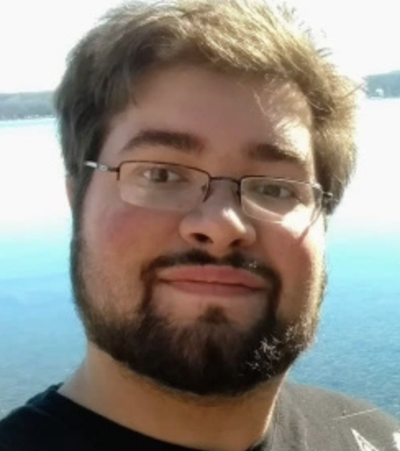
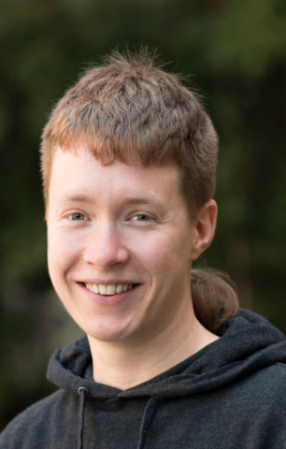
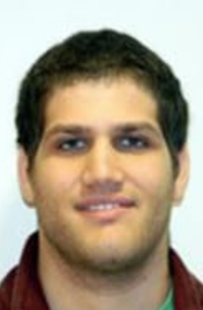
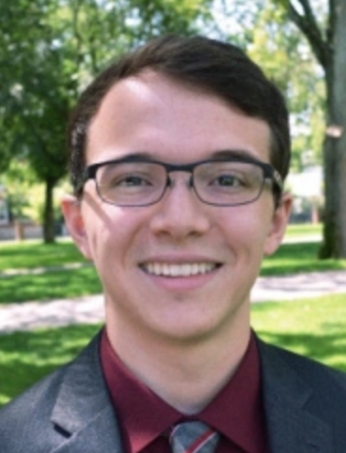
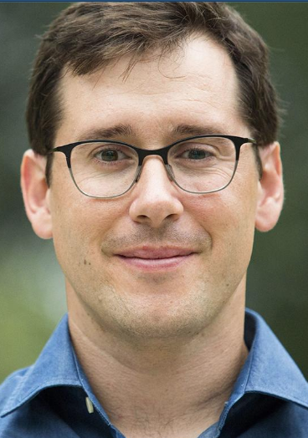
Daniel Rice
Post doc in Human Genetics
Manny Vazquez
Graduate Student in Human Genetics
Grad President, Society for
Advancement of Chicanos/Hispanics and Native Americans in Science (SACNAS)
Jean Morrison
Post doc in Human Genetics
Eric Friedlander
Post doc in Ecology and Evolution
Christian Portas
Undergraduate Student
Undergrad President, SACNAS
President, Socioeconomic Diversity Alliance
John Novembre
Professor of Human Genetics

Slide 4
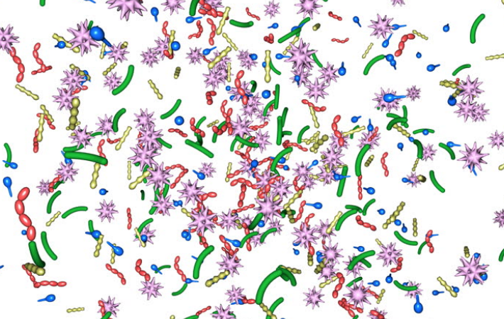


Goals
Day 1: We can learn to code and use code that we’ve written to study biological problems.
Day 2: We can use code to analyze human data.
Day 3: We can use code to perform simulations and inform policy decisions.

